Slide 1

Player Piano
Camden Hunt (BS), Eric Golde (BA)
Advised by Dr. Jeffrey A. Caley, Ph.D
Notes:
EG
Hi everyone! We are the Player Piano Group!
im eric, im camden, and we were advised by the wonderful Dr. Caley.
We’re very excited to show you what we’ve made, so lets get right into it!!!

Slide 2
Abstract
Convert an upright piano into a fully-automatic player piano
Piano can play files from a database of pre-loaded songs
Users can access the list of songs on an easily accessible website to play them on the piano
Notes:
CH
So, the general gist of our project is to convert a regular upright piano into a fully automatic player piano. This isn’t a new idea, and player pianos have actually been around since the late 1800s, operating similarly to a giant music box.
Well, in addition to this, we took it a step further, adding the ability for the piano to play files from an online database of pre-loaded songs. A user can approach the piano and use their own device to access our website allowing them to play songs on the piano

Slide 3
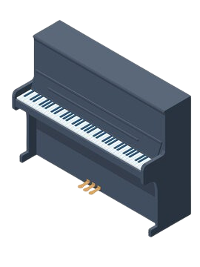
The Piano’s Computer
The User
(part of the piano)
The Piano
(and its many parts!)
Notes:
CH
So for a quick overview of what that looks like, we have the user and their device, which communicates over the web with the computer mounted on the piano. And that computer controls all the hardware on the piano, allowing it to play songs queued by the user

Slide 4
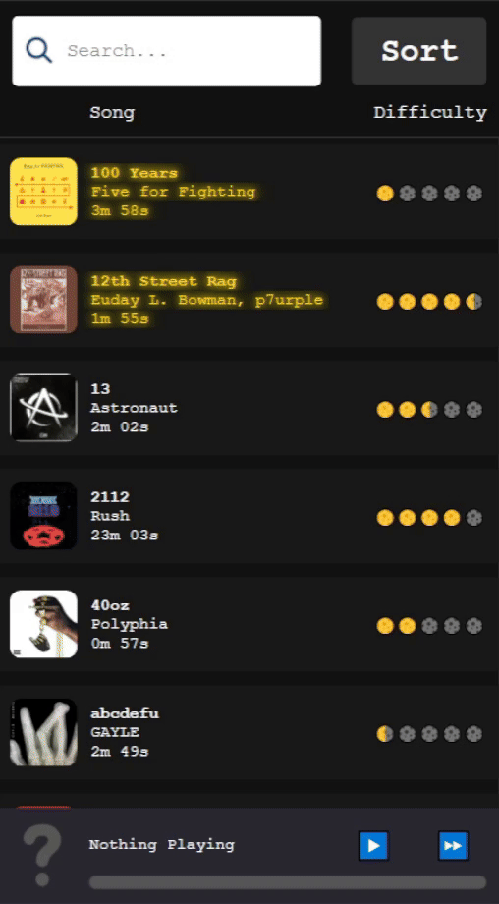
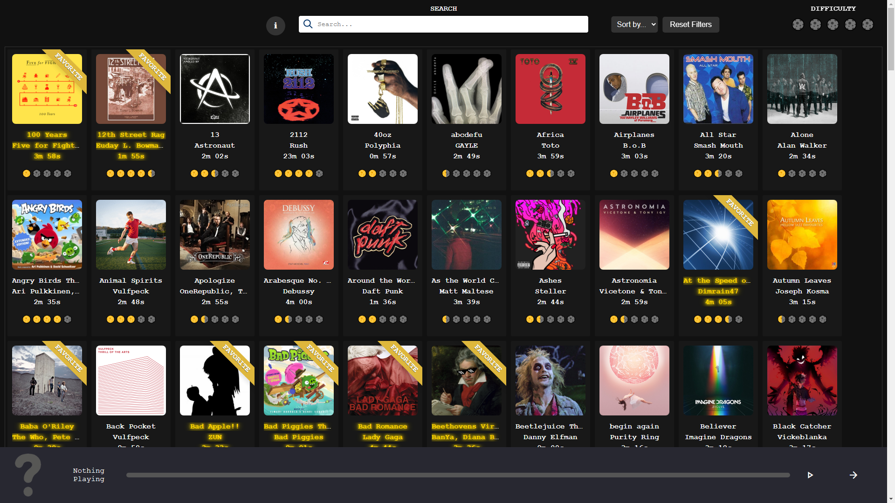
The User
Notes:
CH
First we’re going to take a look at what content the user sees and how they can interact with it (click)
So this here is the website that the user sees, there’s a list of songs, with all the relevant info like title, artist and length and if the song is set as a favorite, that info will appear in gold. There’s also options for the user to sort and filter the list, and search for specific songs. At the bottom of the page, the user can see what song is currently playing, as well options for pausing, unpausing, and skipping songs.
If the user visits the website on desktop, they’ll see a similar webpage with all the same information.
Both websites are programmed in vanilla HTML, CSS and Javascript, with the song data being loaded in from a database on an external server.

Slide 5
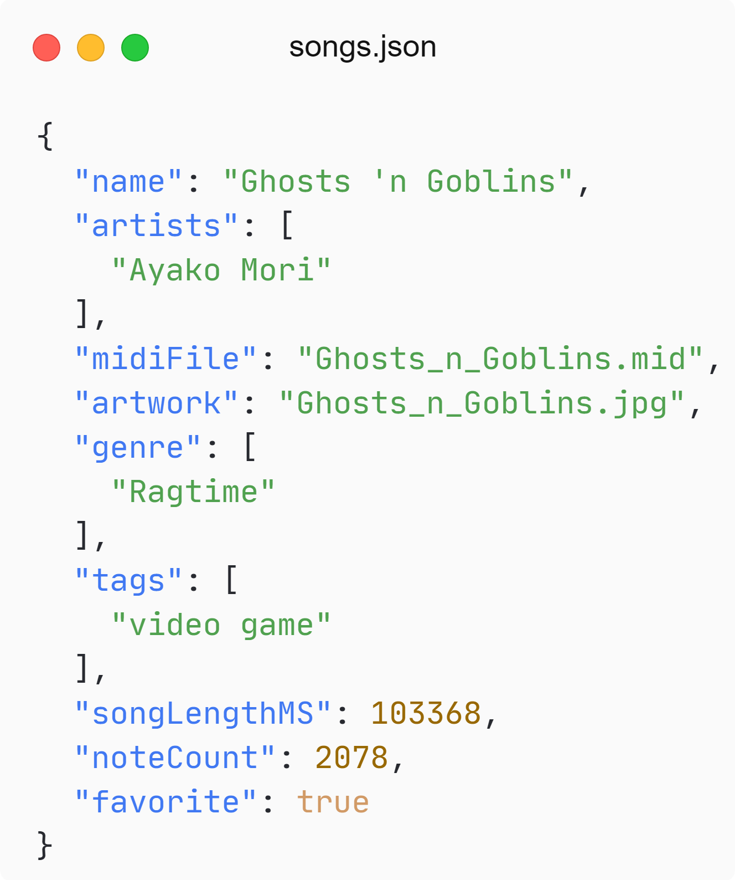
Song Database
auto-generated
Notes:
CH
Speaking of that database, let’s take a look at what a database entry for a single song looks like.
So obviously we need to store identifying information about the song, like the title and artists. A song can have multiple artists, but our example song only has one.
We also need the files associated with the song, like the song itself which we store as a midi file, and the art that goes along with it, which can come in a variety of formats.
The user should also have ways to search for the song, so we have a field for the genre, and for potential search terms. The genre get auto-generated by looking up the song with an API called Discogs, and the tags are really just whatever we think
someone might search to get to the song. With our example, the song is from a video game, so it should appear when the user searches for 'video game'
We also have a script to parse the song for the length and number of notes, so we can let the user sort and filter with those values.
And finally, we have a field called "favorite" that we set to true if we think the song sounds nice, or showcases something cool about the piano's capabilities.

Slide 6
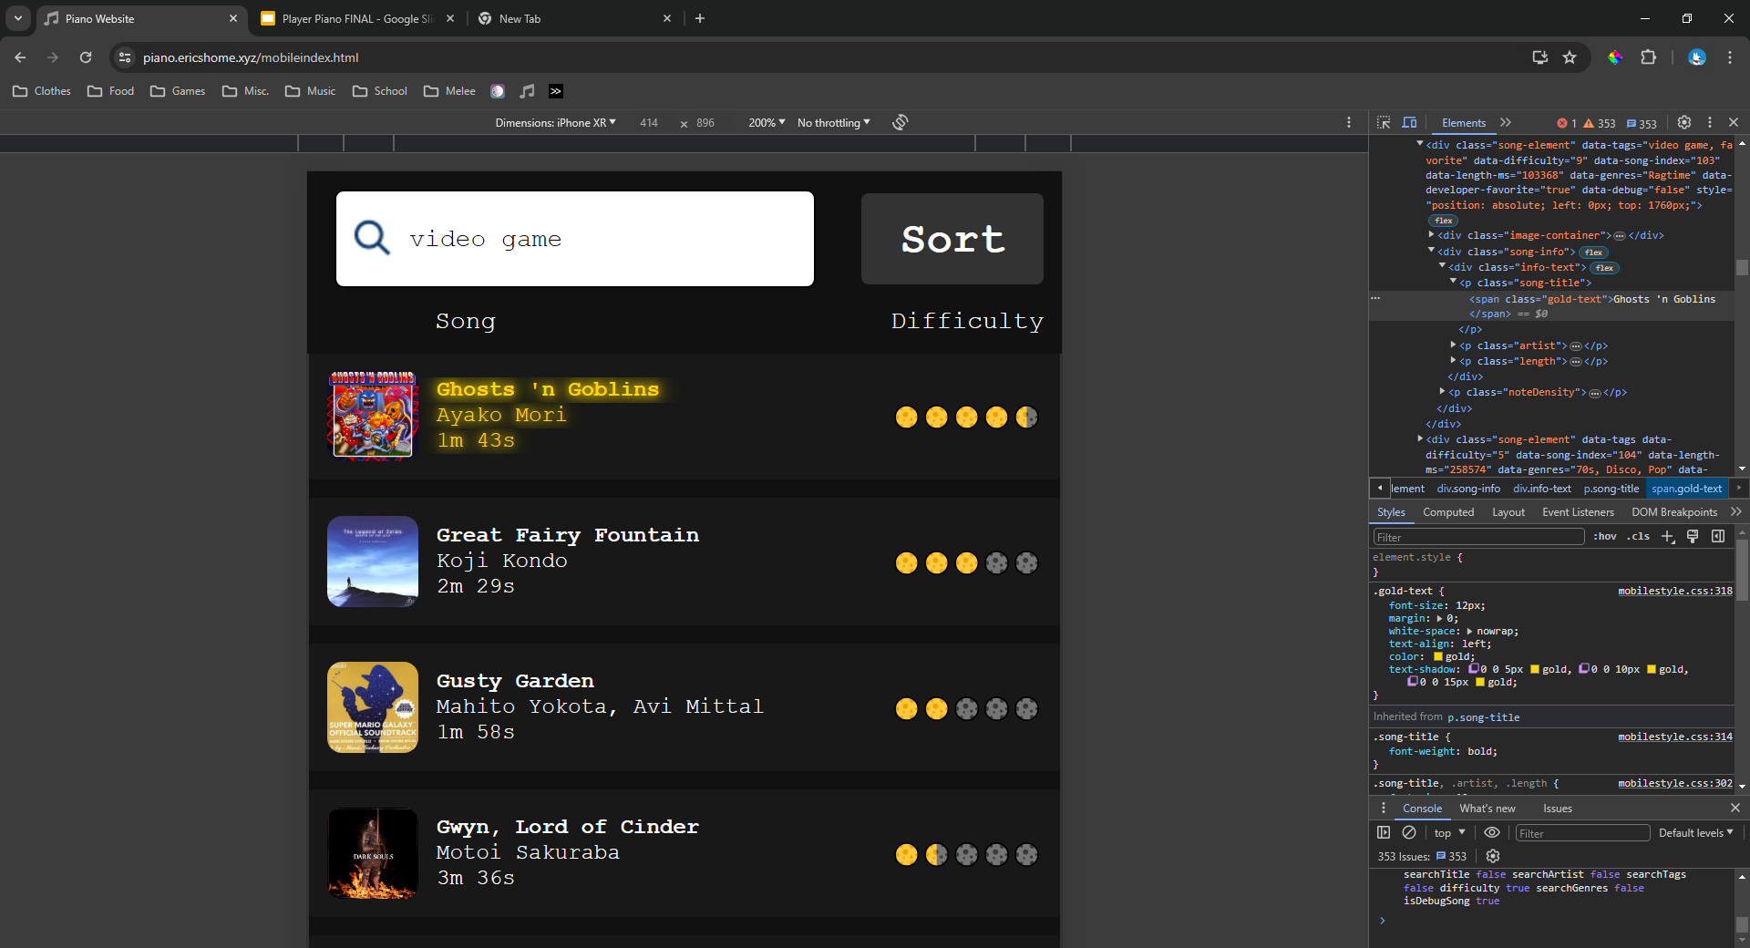
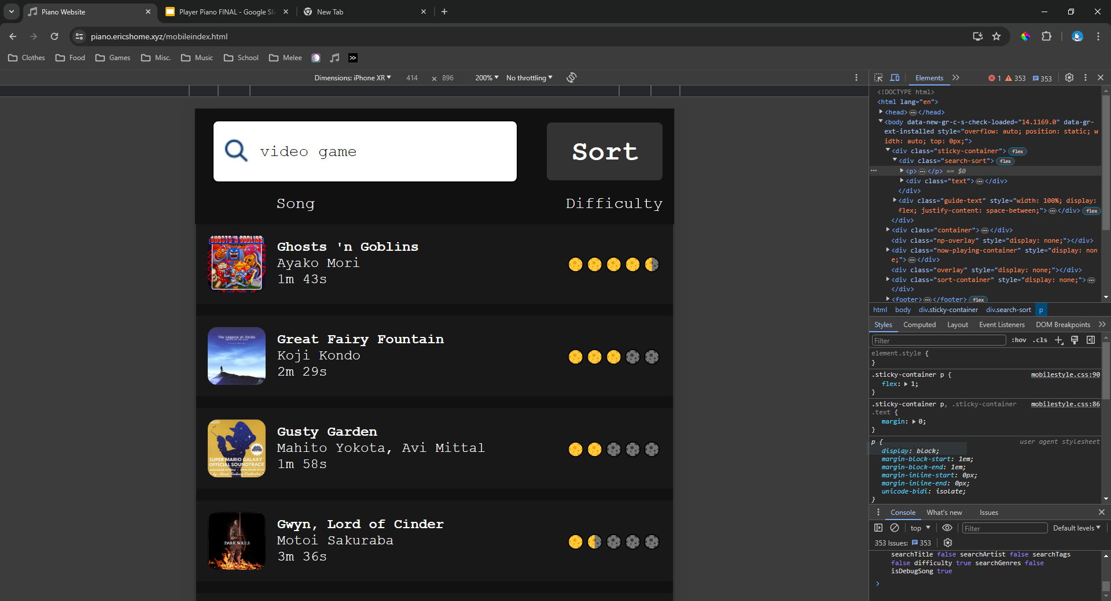
Song Database
Notes:
CH
When the user visits the website, the data gets loaded as you would expect, with the title, artist, and album art being the main things the user sees.
The search term “video game” is in the tags for this song, so it should come up in the results when the user searches for that.
The song length also gets displayed, and that along with the note count are used to calculate the difficulty value.
All we do for the difficulty rating is calculate the density of notes in a song, and assign the song a value between 1 - 10 based on that density value. In reality, judging the difficulty of a piano piece is way more complicated than that and difficulty is subjective, but to the average listener, this value is perfectly fine.
Originally we were back and forth on whether this should be something displayed on the website, but one of the most common questions we get about the piano is asking “what’s the hardest song it can play?” so we ended up including it.
Lastly, we wanted a way to have certain songs we really liked stand out, so a song with the “favorite” tag will have its text colored gold.
And there’s an entry in our database!

Slide 7
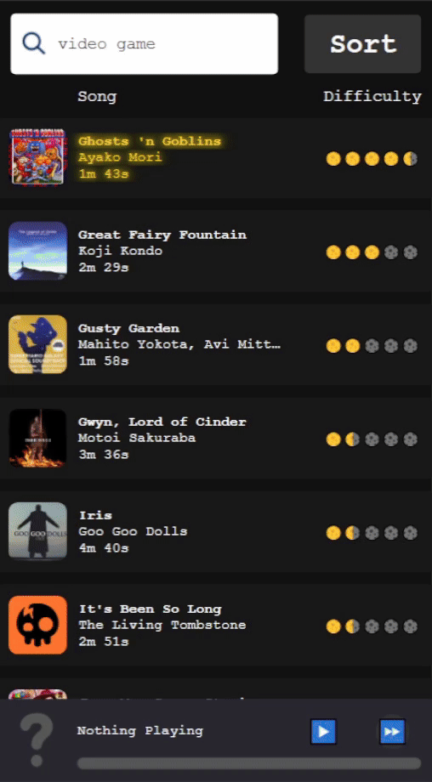
Ghosts_n_Goblins.mid
Notes:
CH
So when all of that is loaded in, the user is free to queue a song, which sends a string to the computer, which lets it know what song to add to the queue

Slide 8
Queueing a Song
Data is sent from the website to the server
Song file is cleaned
Song added to the queue
Notes:
EG
3 Key things happen when a song is queued (Click)
Data is sent from the website to the server
Song file is cleaned
Song added to the queue

Slide 9
Queueing a Song
Data is sent from the website to the server
Song file is cleaned
Song added to queue
Notes:
EG
The data is sent from the website to the computer attached to the piano (Click)

Slide 10
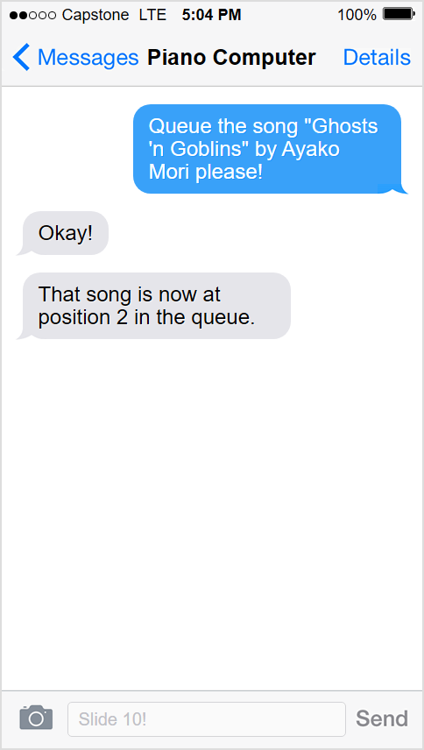
Queueing a Song
Notes:
EG
Whenever the user interacts with the piano, or the piano software needs to send data back to the web client, we use WebSockets, and wrap the data in what we call a Packet.
The easiest way is to think of a packet, with the analogy of SMS texting. It is a ongoing conversation between two devices.
In this instance, we are wanting to queue the song Ghosts and goblins. (CLICK)
The piano will respond with a OK (CLICK)
And then it will process and queue the song. After all the song processing happens, and its added to the queue, it will send a packet to the website (CLICK) letting us know the position in the queue.

Slide 11
Queueing a Song
Data is sent from the website to the server
Song file is cleaned
Song added to queue
Notes:
EG
Next, we want to clean the song file (Click)

Slide 12
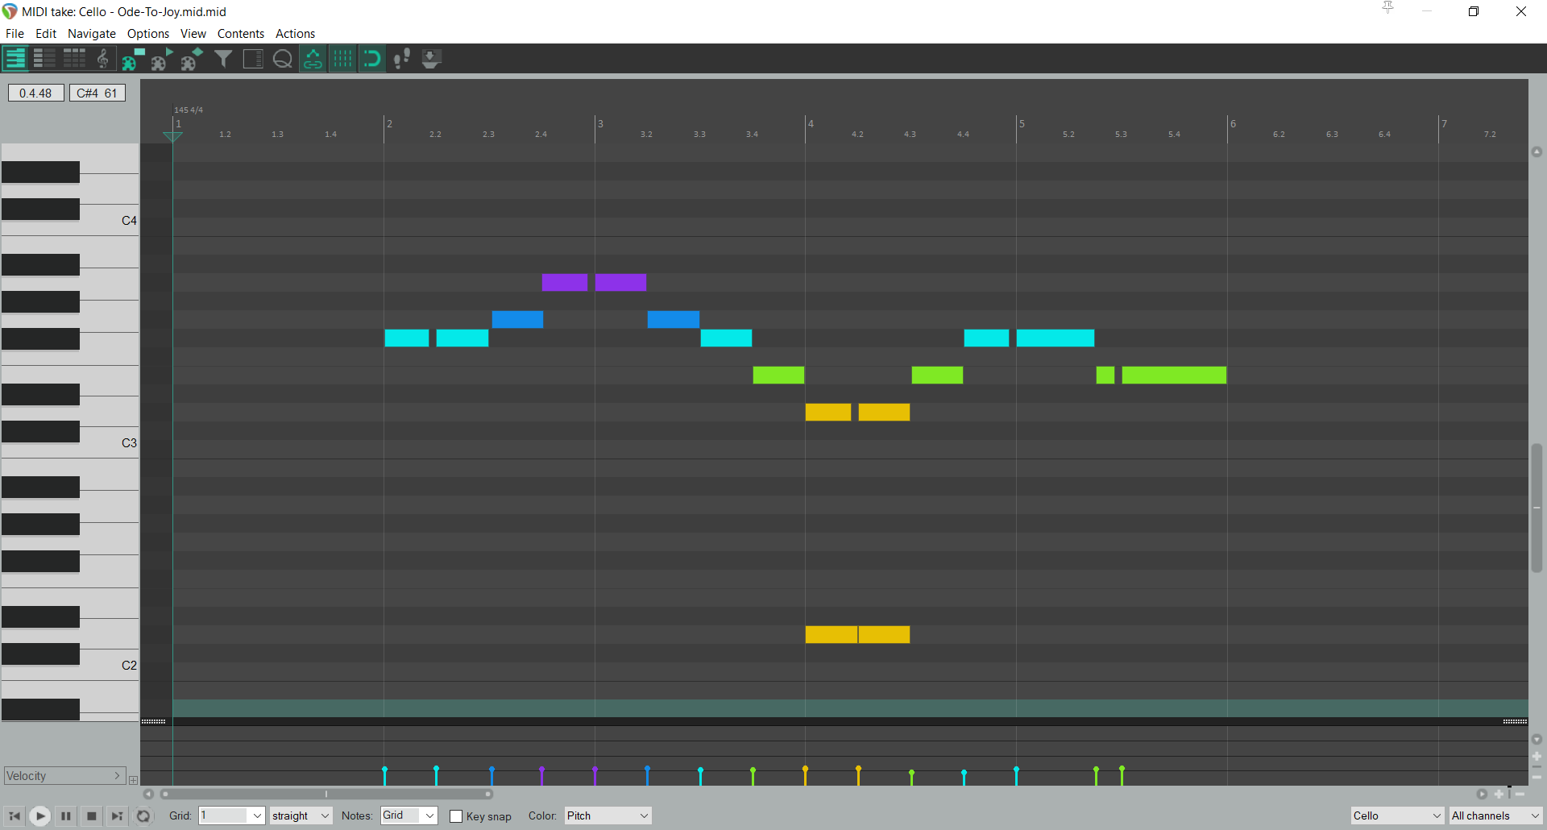


Cleaning the Song
Remove instruments like drums
Notes:
CH
Midi files are designed for digital instruments, without physical limitations. However, our project is very much physical, so we need to adjust the midi files to be playable. (click)
The first step of cleaning the files is to ignore all the instruments that wouldn’t translate well to piano, like drums. Once we do that, we’re left with a file that looks something like this: (click)
So here we have the notes on a timeline, with the higher pitched notes being higher on the chart. Our first step is to get rid of any notes outside the range of the piano. So let’s say these notes (click) at the bottom are lower than the lowest note on the piano, so it can’t play them. The solution is simple, and we just ignore them completely (click). [WIP]
So after we have our file of notes for the piano, we need to make sure the piano can physically play them. The main physical limitation of the piano is in how fast it can play repeated notes on the same key. Since midi files are designed for digital instruments, they don’t account for the time it takes for the key to physically lift up and for the piano to be ready to play another note.
So for example, take this pair of notes (click)
In the midi file, there is no time for the piano key to lift up and be ready in time to hit the second note, so in order to account for this we need to shorten the first note (click)
And of course, we need to do this every time this case comes up (click) so in the end our file looks something like this.

Slide 13
Queueing a Song
Data is sent from the website to the server
Song file is cleaned
Song added to the queue
Notes:
EG
After the song is cleaned, we add the song to the queue. Then the server waits for any more requests for other tasks.
(CLICK)

Slide 14
The Piano’s Computer
(part of the piano)
The Piano
(and its many parts!)
Notes:
CH
Next we’re going to look at how the computer on the piano interacts with the hardware we designed

Slide 15
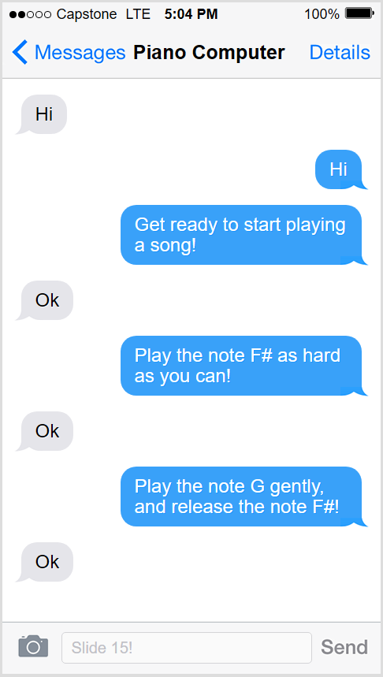
Computer to Piano Communication
Notes:
EG
When the computer and the piano need to communicate, we again are using packets. This time however, the packets are sent over Serial and not WebSockets.
The fundamentals of our Packet wrapper are still at play though. It's another constant ongoing communication between two devices.
In this instance, we can see how the communication between the piano and software running on the laptop would look like.
(Click)
The piano and the computer both negotiate by saying hello, so they now are beginning their conversation (Click)
Then the computer tells the piano were getting ready to play a song (Click)
The piano gets ready, and responds with Okay (Click)
Next we want to send notes, so we tell it we want to play F sharp (CLICK)
Responds with OK (Click)
Then we want to play G softly and release F#, (Click)
The piano does this and tells us it did it.

Slide 16
Start Playing
[ Packet Type ]
[ ‘S’ ]
Song Starting
Notes:
CH
When the user clicks the queue button, and if the queue is empty, the piano controller laptop sends the ‘S’ packet to tell the piano its now starting. This is the simplest example of a packet we send to the piano.

Slide 17
Start Playing
Song Starting!
[ ‘S’ ]
Notes:
CH
The piano responds, and is now ready to begin receiving note packets.
Physically you won’t notice anything different with the piano, but internally, we’re running a few checks to make sure the piano is ready to start playing notes
We want to make sure all the keys are off, the foot petal has been reset, and everything is clear and ready to process data.

Slide 18
Play Note
[ Packet Type, Amount of notes, [ Notes ] ]
Notes: [ Note Number, Velocity]
[ ‘N’, 1, 60, 255]
How many Notes
Middle C on the piano
Play Note
Hit the note as hard as we can
Notes:
CH
Now as the song starts to play, we want to send notes to the piano. (click)
So first we specify the packet type, which in this case is N for “note” (click)
Next we specify the amount of notes to play, which in this case is 1 (click)
Now, we have to specify data about the note we are sending, so for the pitch we tell it 60 for middle C, and for the volume we tell it 255, which indicates max volume (click)

Slide 19
Play Note
Playing a middle C as hard as I can!
[ ‘N’, 1, 60, 1, 255 ]
Notes:
CH
Here we can see when we send this packet, just like with the text message analogy, the piano responds by doing the action!
So when i send that packet to the piano, it does this!:
(hit the button!)

Slide 20
Play Note
[ Packet Type, Amount of notes, [ Notes ] ]
Notes: [ Note Number, Velocity]
[ ‘N’, 2, 60, 255, 67, 127]
How many Notes
Middle C on the piano
Play Note
G4 on the piano
Hit the note only 50% strength
Hit the note as hard as we can
Notes:
CH
Now as the song starts to play, we want to send notes to the piano, maybe multiple at a time
Like before, we specify the packet type, which in this case is N for “note”, as well as the amount of notes to play, this time its 2
Then, we specify the notes, so we tell it 60 for middle C, and 255 for max volume, plus 67 for G4, and 127 for half volume.

Slide 21
Play Notes
Playing middle C as hard as I can, and hitting G4 at half strength!
[ ‘N’, 2, 60, 255, 67, 127 ]
Notes:
CH
As we expect, the piano will perform that action when the data is sent, and waits for any new incoming data
So now when we send this packet, the piano does this:
( Hit the button!)

Slide 22
The Hardware
Notes:
EG
For the next segment of our presentation, we’re going to talk about the hardware we designed to go on the piano

Slide 23

Piano Controller Flow
Error checker
Packet Data
(from computer)
Circuit board
1
Circuit board
2
etc
Circuit board 11
Foot pedal servo
8 solenoids
8 solenoids
8 solenoids
Notes:
EG
Here is an overview of how the data flow happens.
First our packet data that we just discussed is sent over the wire to the (CLICK) arduino
which acts as a translator for the electronics, translating our packet data into electrical signals
It's a small single board computer, commonly found in household appliances like rice cookers and ovens.
If the packet is intended for the foot pedal, (CLICK) we read that information, and send the signal to the foot pedal
otherwise if its a key packet, (CLICK) we send it to the first circuit board.
Each circuit board (CLICK) controls 8 solenoids, and each solenoid hits one key.
A solenoid is basically a magnet with a rod inside, and when its powered, it pushed the rod down, which pushes the key down
As the data exits the first circuit board (Click) it sent to the input of the next board in the chain.
Eventually once we reach the last board (CLICK) we feed the data into our error checker board. This circuit board looks at the data the comes out of the last board, and makes sure it’s what we expect to come out, and sends the comparison result back the the arduino.
If it isn’t want we expect, we know an error has occurred, so the arduino quickly turns everything off and back on again, fixing the interference

Slide 24
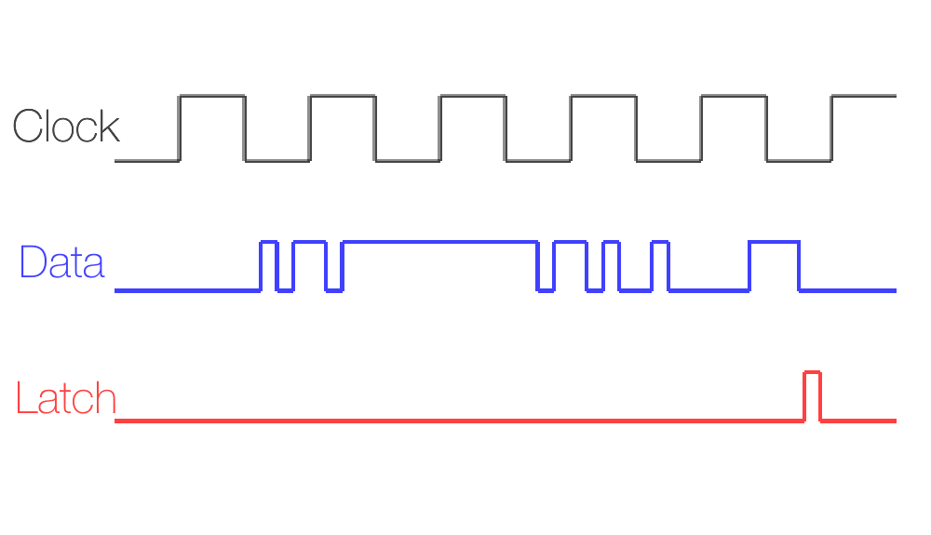
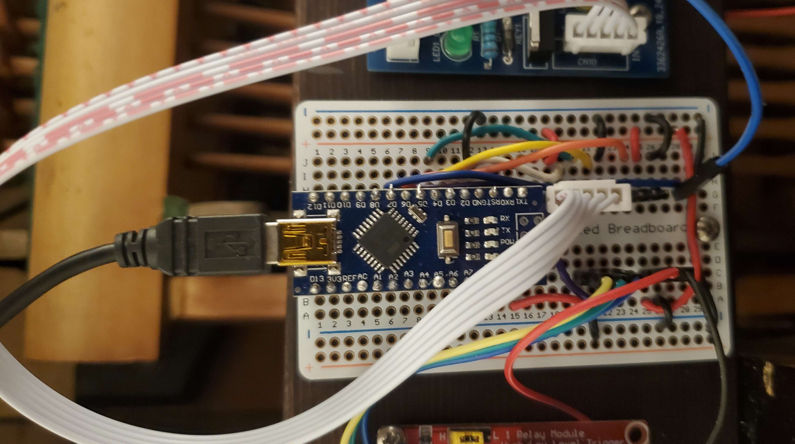
Arduino
[‘N’, 2, 60, 255, 67, 127]
Packet Data
Notes:
EG
Now here’s a picture of the arduino attached to the piano. The USB cable is the incoming packet data we mentioned before, and the white cable is the electrical signals generated by the arduino, being sent to the circuit boards.

Slide 25
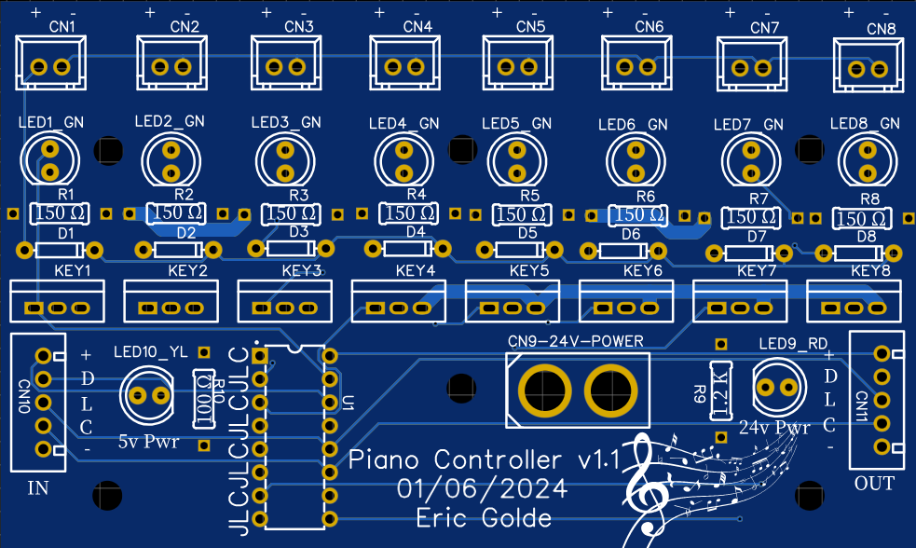
Our Custom Circuit Board
Notes:
EG
This is our custom printed circuit board we designed from scratch, and got manufactured overseas. It ships to us looking something like this.
There are 11 of them in total on the piano, and we have to connect each one of the individually
(CLICK)

Slide 26
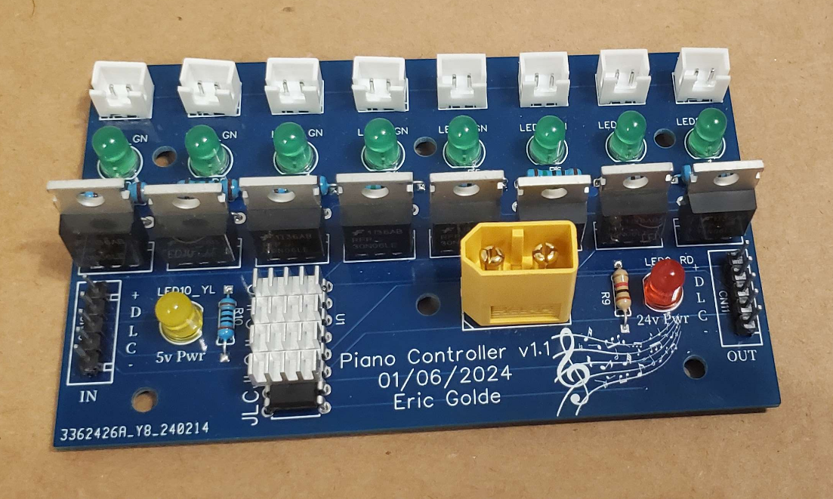
Our Custom Circuit Board
Notes:
EG
Once all the component are soldered on to the boards by hand, it looks something like this. (CLICK)
On the board, we have a number of features that make our custom board unique.
(Click) These are the connectors for the incoming and outgoing data, as well as low voltage power. We use these to connect each of the boards together.
(Click) This is the low voltage debug light. If it turns on, this lets us know at a glance if we have power to the circuit board
(Click) This is the high voltage debug light, if this one turns on, we know the solenoids that hit the keys have power.
(Click) This is the high voltage power connector, which powers the solenoids
(Click) Here is the brains of the board, it takes the incoming signal, and figures out which solenoid the signal needs to go to.
For the sake of simplicity, were only going to look at one column (CLICK) of this board. There are 8 of these column, all exactly the same.
This column consists of 3 main components. The first one being (CLICK) the transistor, which controls the high voltage signal
Next (CLICK) we have the debug light. This lets us which specific solenoids are being powered
And finally (CLICK) we have the connector that connects our custom circuit board with the solenoid that hits the key.

Slide 27
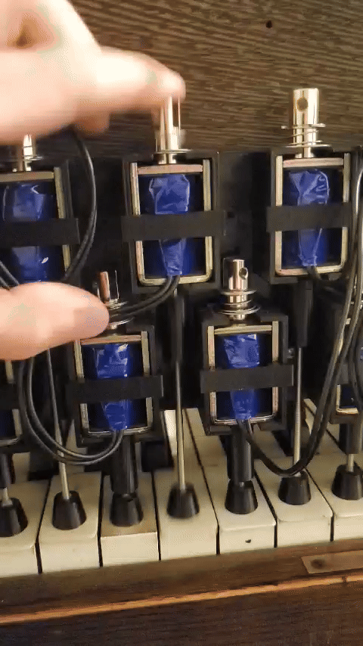
Our Custom Circuit Board
Notes:
Once all the component are soldered on to the boards by hand, it looks something like this. (CLICK)
On the board, we have a number of features that make our custom board unique.
(Click) These are the connectors for the incoming and outgoing data, as well as low voltage power. We use these to connect each of the boards together.
(Click) This is the low voltage debug light. If it turns on, this lets us know at a glance if we have power to the circuit board
(Click) This is the high voltage debug light, if this one turns on, we know the solenoids that hit the keys have power.
(Click) This is the high voltage power connector, which powers the solenoids
(Click) Here is the brains of the board, it takes the incoming signal, and figures out which solenoid the signal needs to go to.
For the sake of simplicity, were only going to look at one column (CLICK) of this board. There are 8 of these column, all exactly the same.
This column consists of 3 main components. The first one being (CLICK) the transistor, which controls the high voltage signal
Next (CLICK) we have the debug light. This lets us which specific solenoids are being powered
And finally (CLICK) we have the connector that connects our custom circuit board with the solenoid that hits the key.

Slide 28
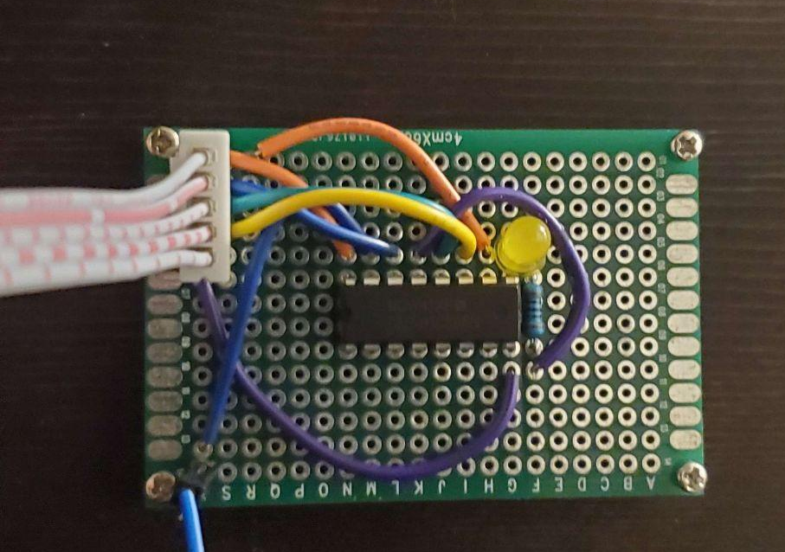
Error Checker
Notes:
EG
This is the Error checker board. We built this after lots of testing, and finding out there’s occasionally some electrical interference with all of our solenoids.
We developed this pretty late into the project, and because of this, we did not have time to get this board manufactured overseas.
As mentioned previously, this board makes sure the data coming out is what we expect to come out, and relays a signal back to the Arduino
If any issues occur, we stop sending the data, reset everything, and then start sending the data again right where we left off.
Issues can occur for a variety of reasons, like things overheating, or electrical interference. But with this solution, we should be able to detect errors caused by whatever may come up

Slide 29
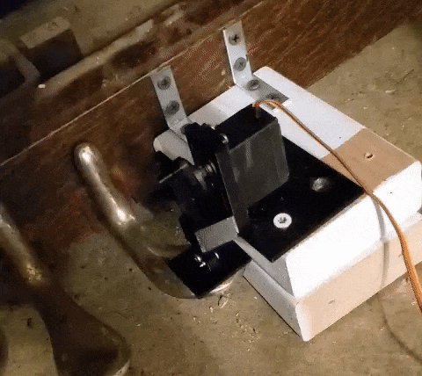
Sustain Pedal
Notes:
EG
This is the foot pedal that controls sustain on the piano. We don’t have this currently hooked up since it makes it really hard to move around
The sustain pedal has a motor attached to it, that can press or release the pedal on command when a packet is sent by the arduino telling it to do so
The motor is slow, so we have to account for its slowness when sending packets, so we send all of the sustain pedal packets half a second early to account for the time it takes to move

Slide 30
Issues Encountered
Electromagnetic interference is frustrating and time consuming
Chips overheat occasionally
MIDI files are weird
Off notes VS 0 velocity
MIDI Versions
MIDI tempo changes
Web development parity is difficult
Notes:
EG
As you may have expected, with a project this large, we ran into some issues.
Bringing projects to the physical world is its own unique set of challenges. While something may look right on a schematic or in code, accounting for things like electromagnetic interference (CLICK) has been its own challenge.
While most issues with this are fixed, occasionally the error checker fails to detect issues.
However, if this happens, manually turning the piano on and off usually fixes the issue (Click)
Sometimes the chips on the boards get very hot and shut down. Since encountering this error, we added heat sinks to the chips to help, but sometimes if the piano has been running for a long time, this still comes up. (click)
We also ran into some problems with interpreting the midis files (click)
In midi data, there are 2 ways say that a note is turning off, either you simply tell it to turn off, or you tell it to play a note with 0 volume. In our code, we had to account for this, and make sure the piano could do either (click)
(VERSION CLICK)
Midi also has multiple different types of timings you can use. Finding out how to calculate it correctly for each different midi versions took many hours of frustration, but in the end it worked out. (TIMINGS CLICK)
These types of timings can also speed up or slow down throughout the song, so making sure it was done correctly was another long battle. (click)
Another issue that came up was making sure the website would work on both desktop and mobile. Making a website accessible for a variety of screen sizes, and making sure the buttons were fully functional for touch screens was something that we had never done in the past, so it was an interesting set of problems to overcome.

Slide 31


Demo!
Fantaisie-Impromptu by Frédéric Chopin
Ghosts 'n Goblins by Ayako Mori
Notes:
CH
We have a couple demo songs prepared for you today, the first of which being “Fantaisie-Impromptu” by Chopin.
That was our first demo song,
The second song we have prepared today is “Ghosts ‘n Goblins” by Ayako Mori, which you may recognize as our example song from earlier in the presentation

Slide 32
Questions?
Notes:
CH
Well that concludes our presentation, does anyone have any questions for us?

Slide 33
For more:
Dr. Rae Linda Brown Undergraduate Research and Creative Projects Showcase
12:30pm - 1:30pm @ AUC.
May 10, 2024
Thank you!
Special shoutout to: Cass Hunt, AJ Moore, Axel Ericson, Tyler Stratton, & Cole Stewart
Notes:
CH
(If anyone wants to look more closely at the piano, or try it out, feel free to come up during the break after the next presentation and check it out!)

